Slide 1

Case planning and Statement of Work (SOW)
15/9/10 - Revision 6 - RHJ
<number> | 2010

Slide 2
Congratulations.
You have won the contract!
The customer need his product a.s.a.p.
So, get started now!

Slide 3
Case work flow
Terma case
Systematic case
Terma case
Systematic case
SOW
U.C. Req.
SOW
U.C. Req.
SOW
U.C. Req.
SOW
U.C. Req.
Contract to
prime
MSR
Del. Doc.
Contract to
prime
MSR
Del. Doc.
Contract to
prime
MSR
Del. Doc.
Contract to
prime
MSR
Del. Doc.
Company
A
Contract to
subcontractor
Company
B
Contract to
subcontractor
Company
C
Contract to
subcontractor
Company
D
MRS
Del. Doc.
MRS
Del. Doc.
MRS
Del. Doc.
Contract to
subcontractor
MSR
Del. Doc.
Contract to
subcontractor
MSR
Del. Doc.
Company
E
Contract to
subcontractor
Company
F
Contract to
subcontractor
Company
G
Contract to
subcontractor
Company
H
MRS
Del. Doc.
MRS
Del. Doc.
MRS
Del. Doc.
Contract to
prime
MSR
Del. Doc.
Contract to
prime
MSR
Del. Doc.
Contract to
prime
MSR
Del. Doc.
Contract to
prime
MSR
Del. Doc.
Systematic case
Terma case
Systematic case
Terma case
SOW
U.C. Req.
SOW
U.C. Req.
SOW
U.C. Req.
SOW
U.C. Req.
SOW – Statement of Work
MSR – Milestone review
Del. Doc = deliverable documentations
U.C. Req. = Use Case Requirements
<number> | 2010

Slide 4
Contractors and sub-contractors
Company A
  Prime contractor to Terma case
  Subcontractor to Company B
Company B
  Prime contractor to Systematic case
  Subcontractor to Company C
Company C
  Prime contractor to Terma case
  Subcontractor to Company D
Company D
  Prime contractor to Systematic case
  Subcontractor to Company H
Company E
  Prime contractor to Systematic case
  Subcontractor to Company A
Company F
  Prime contractor to Terma case
  Subcontractor to Company E
Company G
  Prime contractor to Systematic case
  Subcontractor to Company F
Company H
  Prime contractor to Terma case
  Subcontractor to Company G
<number> | 2010

Slide 5
Case input: Customer requirements
Terma
Statement of Work
Use Case Requirements (U.C. Req.)
Systematic
Statement of Work
Use Case Requirements (U.C. Req.)
<number> | 2010

Slide 6
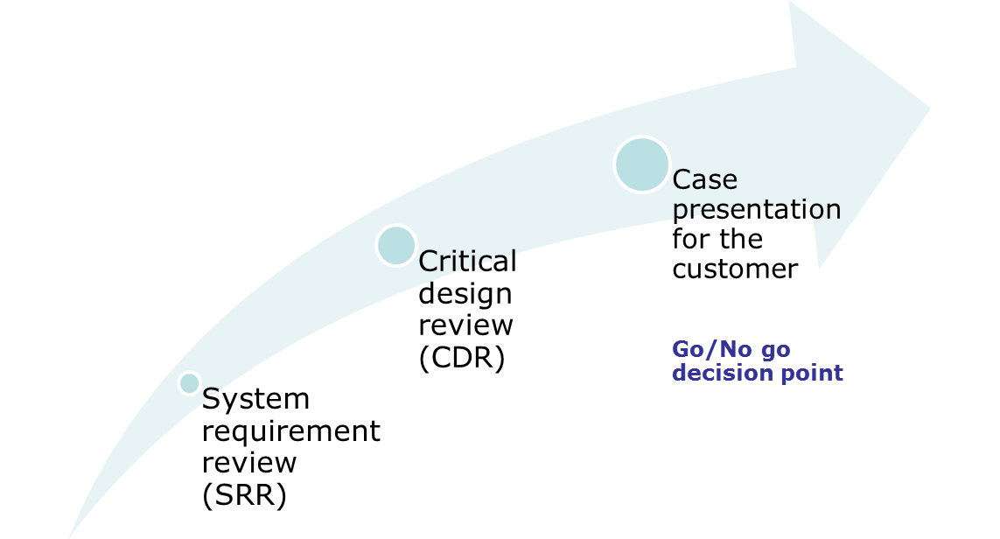

Timeline for case work
15/10-2010
11/10-2010
28/9-2010
3/9-2010
Contract win
<number> | 2010

Slide 7
Responsibilities (1 of 2)
Prime-contractor’s MSR with the end-customer and the QA consultant:
  All documents for the MSR shall be delivered to the customer no less that 72 hours in advance
  Delivery information:
  Terma: mhn@terma.com; mih@terma.com; tov@terma.com
  Systematic: Anders.Jacob.Truelsen@Systematic.com
  QA consultant: rhj@iha.dk
  All documents shall be in PDF format
  All documents shall be revision controlled
  The MSR shall be conducted at an agreed time on the dates specified by the end-customer
  It is the prime-contractor’s responsibility that the MSR time is not conflicting with other MSR’s
<number> | 2010

Slide 8
Responsibilities (2 of 2)
Subcontractor’s MSR with the prime-contractor:
  The MSR shall be conducted outside class lectures
  The requirements for the documentation is the same as for the prime-contractor’s MSR with the end-customer.
  Minutes of Meeting (MoM) from the MSR shall be sent to the end-customer and the QA consultant by the prime contractor no less that 48 hours after the MSR meeting
  MoM shall be in PDF format containing a max. of 1000 words.
<number> | 2010

Slide 9
Required documentation for review meetings
Review | Delivery documentation | Comments
SRR | MA: Project plan | Schedule with all MSR w/ stakeholders)
 | MA: System Requirement Specification | Requirements analysis based on U.C. Req.
 | OP: List of all subsystems and subcontractors | Based on preliminary design sketches
CDR | MA: Detailed Design Description | The system is designed with all subsystems including subcontractor’s design(s) design documentation
 | MA: ICD | All interfaces described (SW/HW)
 | MA: Verification Matrix | Verification method for all requirements
MA = Mandatory delivery
OP = Optional delivery

Slide 10
Systems Engineering teams in companies A-H
Company A Amos Hoste Anders Petersen Søren Aa. Mikkelsen Nikki Ashton Jeremi V. Kiruparajan Lasse H. Rasmussen Nikolaj Tørring | Company B Ba Thy Thu Søren Dalsgaard Ulrikkeholm Allan Nielsen Zoi Kostopoulou Rony Aywan Teddy Holm Roskvist Jesper Jakobsen | Company C Brian V.Danielsen Kristoffer L. Jakobsen Frederik Ø.Laulund Anders Bo Nielsen Maria Soler Climent Lasse V. Hansen Michael Owsinski | Company D José Antonio Esparza Isasa Adam Enø Jensen Martin S. Madsen Martin G. Olsen Rene G. Stenner Lars W. Jochumsen
Company E Anders Torndahl Christian Jensen David N.R. Marmoy Michael N. Pedersen Peter H. Mikkelsen | Company F Hardy Rusbjerg Kaj Norman Kenneth Pihl Lars Munch Michael B. Mogensen Anders H. Poder | Company G Klaus Kolle Morten O. Jakobsen Frank Andersen Bodil Bruun Jørgen V. Hansen Said Shah Alizadeh | Company H Anders Bloch Jesper Bærentzen Erik Eskjær Øbakke Jens Klinting Ole Lysgaard Torben T. Dissing
Main contact person is underlined
<number> | 2010

Slide 11
Questions and support issues
Planned consultation (17/9 at 10-12)
An optional consultation is planned at IHA. Location to be announced on CampusNet. Companies shall send only one representative.
Questions sent no later that 48 hours before the consultation will be given highest priority. Questions must be prioritized due to time constraints.
Contact information for QA consultant
Rune Jacobsen (rhj@iha.dk)
IHA, Office 407b
Phone: +45 8730 2526
<number> | 2010

